Slide 1
Requirement Elicitation Techniques
Asma Sajid

Slide 2
Techniques
Brainstorming
Existing System study/Document Analysis
Interface Analysis
Interview
Ethnography/Observation
Prototyping
Requirements Workshop
Reverse Engineering
Survey/ Questioners
Scenarios/Story Boards

Slide 3
Develop SMART requirements
Make sure the requirement is:
Specific –clearly states what is required
Measurable – to confirm when it has been met
Achievable – can be done, eg. technically possible
Realistic – is reasonable, eg. cost is not prohibitive
Timely – achievable within an acceptable timeframe.
If the requirements do not conform to these criteria the Business Analyst must discuss this and reach agreement with the requester.

Slide 4
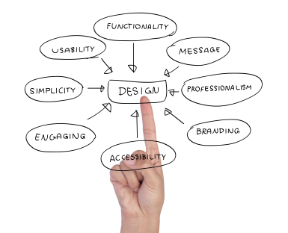
1. Brainstorming
1. Brainstorming
Brainstorming is used in requirements elicitation to get as many ideas as possible from a group of people.
Generally used to identify possible solutions to problems, and clarify details of opportunities.
Brainstorming casts a wide net, identifying many different possibilities.
Prioritization of those possibilities is important to finding the needles in the haystack.

Slide 5
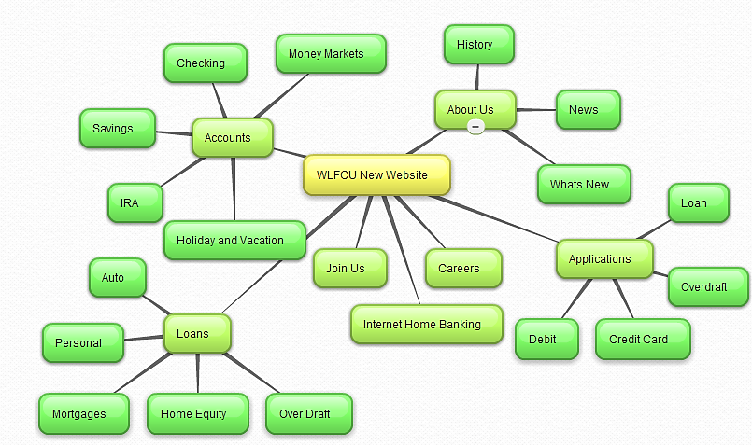
Brainstorming example

Slide 6
2. Document Analysis
Reviewing the documentation of an existing system can help when creating AS-IS process documents, as well as driving gap analysis for scoping of migration projects.
In an ideal world, we would even be reviewing the requirements that drove creation of the existing system – a starting point for documenting current requirements.
Nuggets of information are often buried in existing documents that help us ask questions as part of validating requirement completeness.

Slide 7
3. Focus Group
A focus group is a gathering of people who are representative of the users or customers of a product to get feedback.
The feedback can be gathered about needs / opportunities / problems to identify requirements, or can be gathered to validate and refine already elicited requirements.
This form of market research is distinct from brainstorming in that it is a managed process with specific participants.
There is danger in “following the crowd”, and some people believe focus groups are at best ineffective. One risk is that we end up with the lowest common denominator features.
4. Interface Analysis
Interfaces for a software product can be human or machine.
Integration with external systems and devices is just another interface.
User centric design approaches are very effective at making sure that we create usable software. Interface analysis – reviewing the touch points with other external systems – is important to make sure we don’t overlook requirements that aren’t immediately visible to users.

Slide 8
5. Interview
Interviews of stakeholders and users are critical to creating the great software. Without understanding the goals and expectations of the users and stakeholders, we are very unlikely to satisfy them. We also have to recognize the perspective of each interviewee, so that we can properly weigh and address their inputs. Like a great reporter, listening is the skill that helps a great analyst to get more value from an interview than an average analyst.

Slide 9
6. ETHNOGRAPHY /Observation
The study of users in their natural habitats is what observation is about. By observing users, an analyst can identify a process flow, awkward steps, pain points and opportunities for improvement. Observation can be passive or active (asking questions while observing). Passive observation is better for getting feedback on a prototype (to refine requirements), where active observation is more effective at getting an understanding of an existing business process. Either approach can be used to uncover implicit requirements that otherwise might go overlooked.
7. Prototyping
Prototypes can be very effective at gathering feedback. Low fidelity prototypes can be used as an active listening tool. Often, when people can not articulate a particular need in the abstract, they can quickly assess if a design approach would address the need. Prototypes are most efficiently done with quick sketches of interfaces and storyboards. Prototypes are even being used as the “official requirements” in some situations.

Slide 10
8. Requirements Workshop(JAD)
More commonly known as a joint application design (JAD) session, workshops can be very effective for gathering requirements. More structured than a brainstorming session, involved parties collaborate to document requirements. One way to capture the collaboration is with creation of domain-model artifacts (like static diagrams, activity diagrams). A workshop will be more effective with two analysts than with one, where a facilitator and a scribe work together.
9. Reverse Engineering
Is this a starting point or a last resort? When a migration project does not have access to sufficient documentation of the existing system, reverse engineering will identify what the system does. It will not identify what the system should do, and will not identify when the system does the wrong thing.

Slide 11
Joint Application Development (JAD)
The goal of JAD is to involve all stakeholders in the design phase of the product via highly structured and focused meetings.
Used for validation of the requirements
Process of JAD:
  Typical participants in the session involve end users, developers, observers and a facilitator.
  The requirement engineering team is assigned task to find and gather information.
  The output of this assignment is taken as requirements. The real JAD session is then.

Slide 12
10. Survey
When collecting information from many people – too many to interview with budget and time constraints – a survey or questionnaire can be used.
The survey can force users to select from choices, rate something (“Agree Strongly, Agree…”), or have open ended questions allowing free-form responses.
Survey design is hard – questions can bias the respondents. Don’t assume that you can create a survey on your own, and get meaningful insight from the results.
A well designed survey would provide qualitative guidance for characterizing the market. It should not be used for prioritization of features or requirements.

Slide 13
11. Scenarios
Scenarios are stories which explain how a system might be used. They should include
  a description of the system state before entering the scenario
  the normal flow of events in the scenario
  exceptions to the normal flow of events
  information about concurrent activities
  a description of the system state at the end of the scenario
Discovering scenarios exposes possible system interactions and reveals system facilities which may be required.
Design scenarios by using Use cases, Sequence Diagrams, interaction diagrams.

Slide 14
Ethnography (Observation) & social analysis
People often find it hard to describe what they do because it is so natural to them. Sometimes, the best way to understand it is to observe them at work
Ethnography is a technique from the social sciences which has proved to be valuable in understanding actual work processes.
Actual work processes often differ from formal, prescribed processes.
An ethnographer spends some time observing people at work and building up a picture of how work is done

Slide 15
Ethnography
Ethnography (etnos=people, race; grafia=writing, description) is defined as a systematic process, through which models of culture or subculture are observed, described, documented and analyzed. (Pelto & Pelto 1978, Agar 1980, Nikkonen & Janhonen 1995.)
  People do not have to explain or articulate their work.
  Social and organisational factors of importance may be observed.
Focused Ethnography= Ethnography aimed to solve a specific problem is termed as “focused ethnography”.
  Developed in a project studying the air traffic control process
Drawback =The problem with ethnography is that it studies existing practices which may have some historical basis which is no longer relevant

Slide 16
Interview or workshop?
Interview when:
  requirements are detailed
  requirements cover many areas of knowledge that have specific individuals who are the experts
  differing opinions are likely or are sought
Workshop when:
  requirements are high level
  requirements are focused on one area of business in which the participants have knowledge
  consensus is being sought

Slide 17

For more lectures
Subscribe at:
asma sajid
https://www.youtube.com/c/asmasajid

